Slide 1
South Lake Tahoe Incident Review
Rihaan Gangat
ZOA CWSU
NWS Meteorologist

Slide 2
Outline
Overview
Meteorology
Analysis
Probable Cause
Conclusion

Slide 3
Overview
Detailed final report by
National Transportation Safety Board (NTSB)
Meteorology by Meteorologist
Paul Suffern (NTSB)

Slide 4
Overview
October 15, 2016 at 1552 PDT
Cessna 182D crashed the eastern face of Red Peak Mountain in the Desolation Wilderness near South Lake Tahoe, CA.
Private pilot sustained fatal injuries
Airplane destroyed

Slide 5
Overview
Departed Winnemucca Municipal Airport in Winnemucca, NV
Planned destination: Westover Field/Amador County Airport in Jackson, CA
MVFR conditions w/RA prevailed at Lake Tahoe Airport, 10 miles east of the accident site
No flight plan had been filed

Slide 6
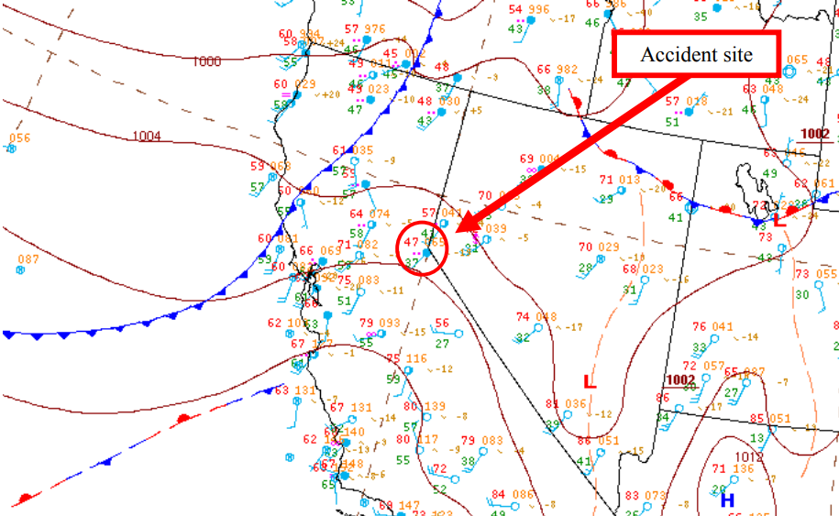
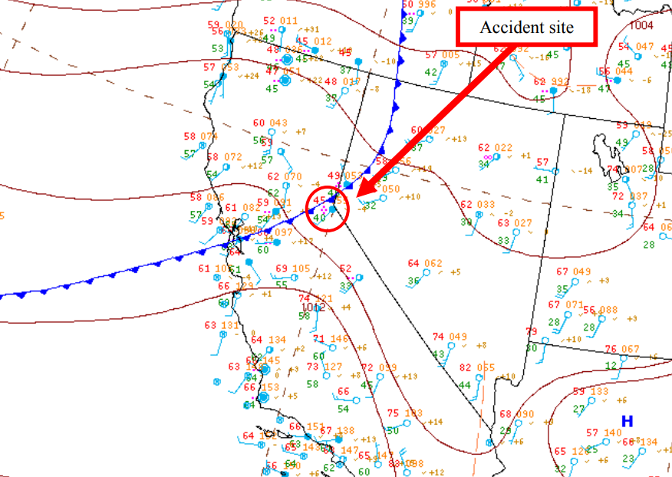
Meteorology
Notes:
Surface low pressure observed southeast of accident site. Cold front observed in NW Cali at 1700 moving southeast over the accident site by 2000. Moderate to heavy rain reported around accident site at 1700. Frontal boundaries near mountains can act to aid in the mixing of low level air, allowing LLWS, mountain waves, and turbulence to occur.

Slide 7
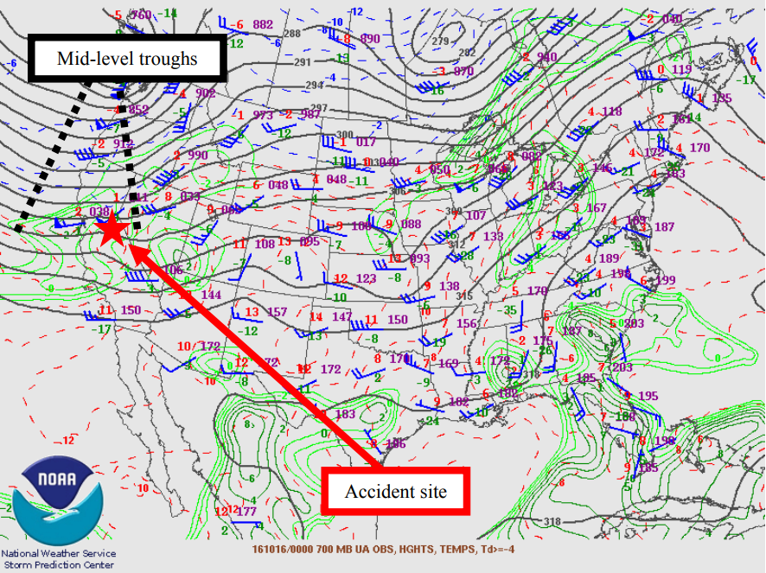
Meteorology
Notes:
Mid-level trough east & west of accident site. Troughs act as lifting mechanisms where enhanced lift, gusty winds, fronts, clouds, and precip can occur.

Slide 8
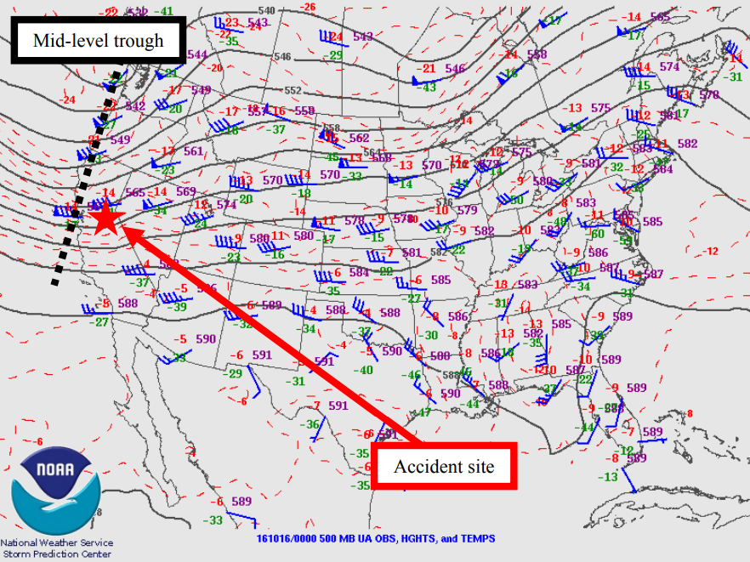
Meteorology
Notes:
Mid-level trough present west of accident site

Slide 9
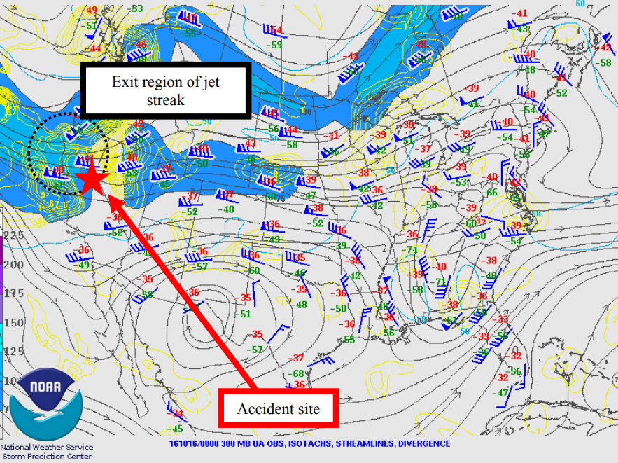
Meteorology
Notes:
Accident site was located in exit region of jet streak – enhanced lift, clouds, precip can occur.

Slide 10
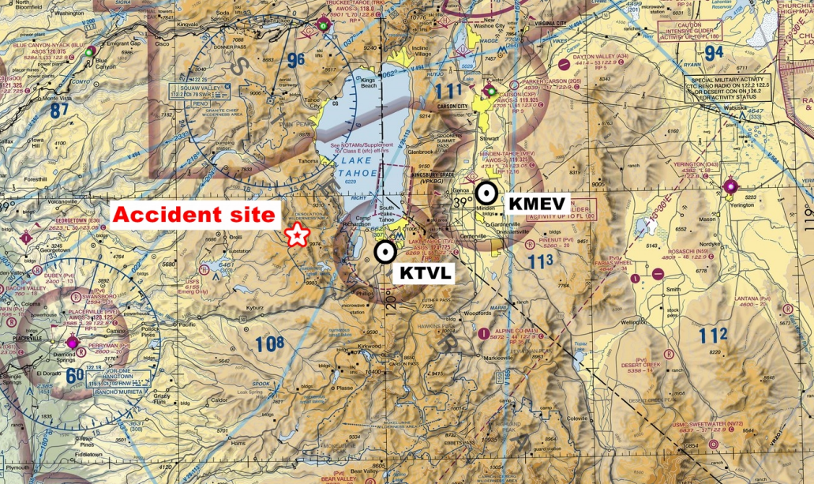
Meteorology
Notes:
Lake Tahoe Airport had the closest official weather station to accident site while Minden-Tahoe Airport was the second closest

Slide 11

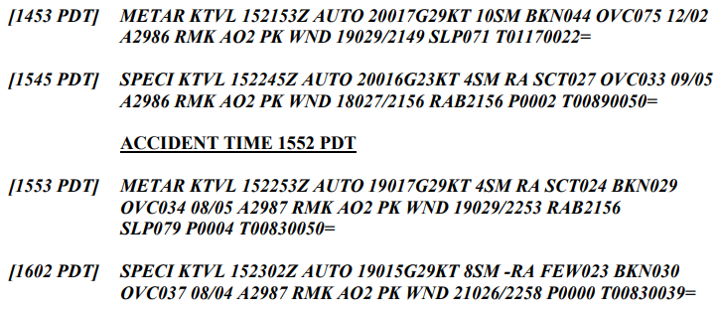
Meteorology

Slide 12
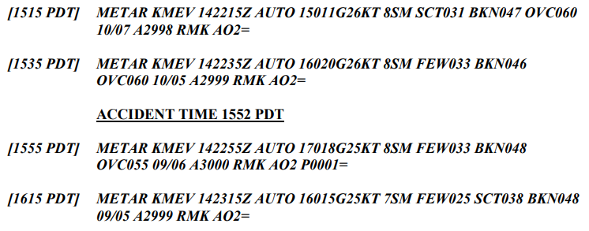
Meteorology

Slide 13
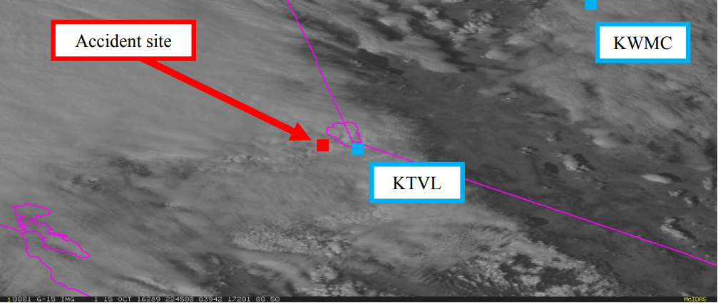
Meteorology
Notes:
Clouds rapidly increasing. Between KWMC and KTVL there were lenticular clouds indicated in NV – indication of great instability leading to turbulence and mountain waves.

Slide 14
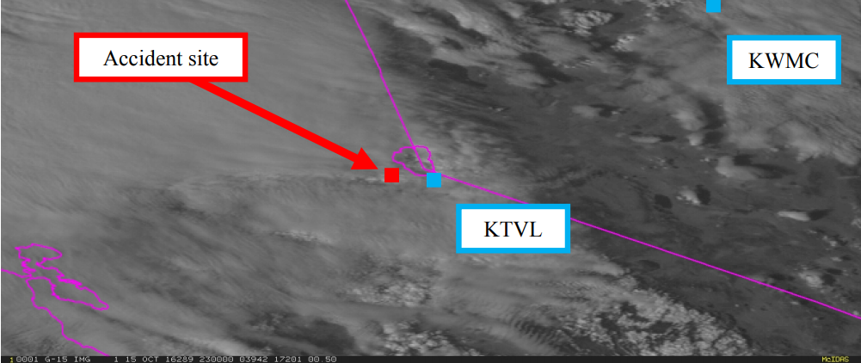
Meteorology
Notes:
Clouds rapidly increasing. Between KWMC and KTVL there were lenticular clouds indicated in NV – indication of great instability leading to turbulence and mountain waves.

Slide 15
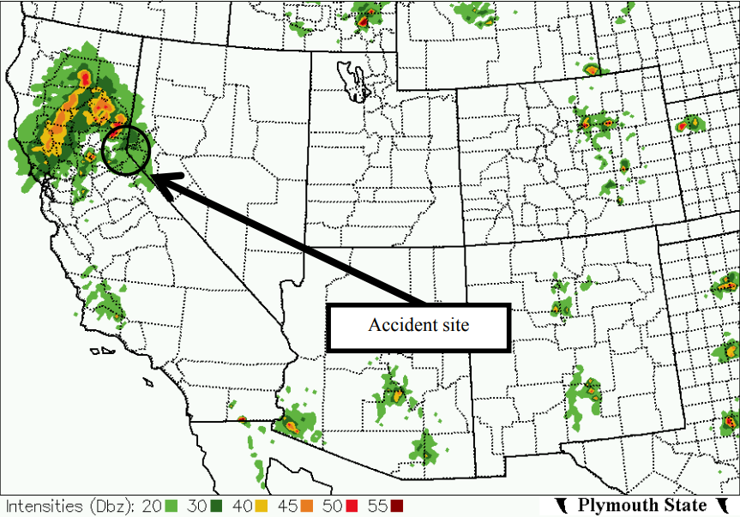
Meteorology

Slide 16
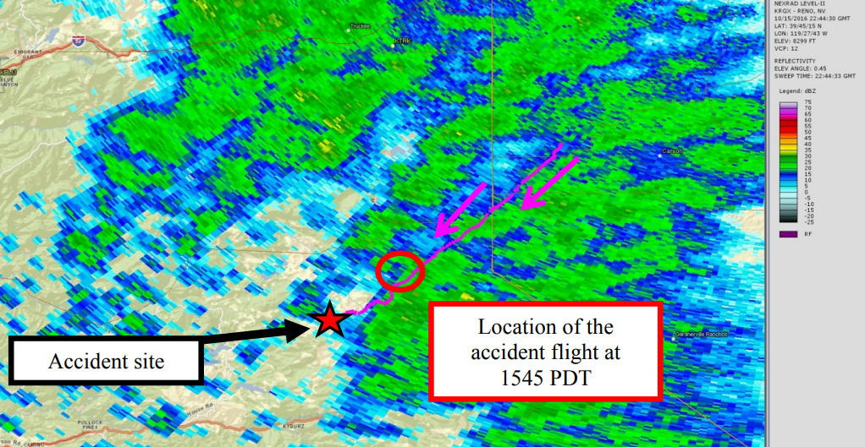
Meteorology
Notes:
The ATC flight track is included with arrows pointing in the direction of travel (pink line). This indicates aircraft flew thru 5-30 dBZ located along the route of flight before 1551 PDT with precip moving from southwest to northeast.

Slide 17
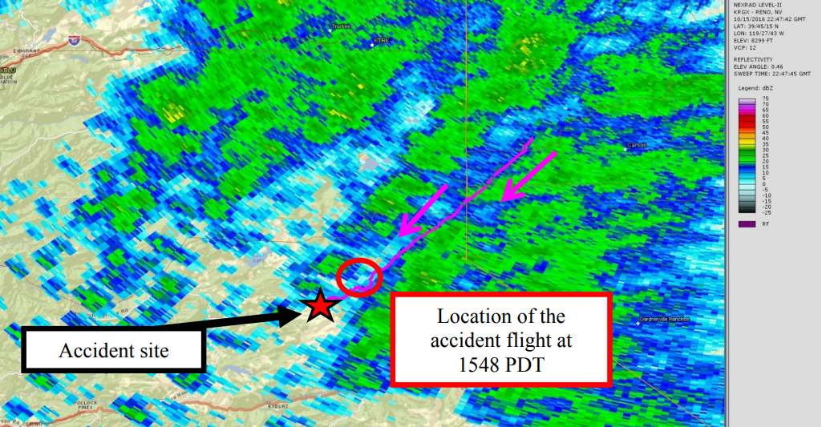
Meteorology

Slide 18
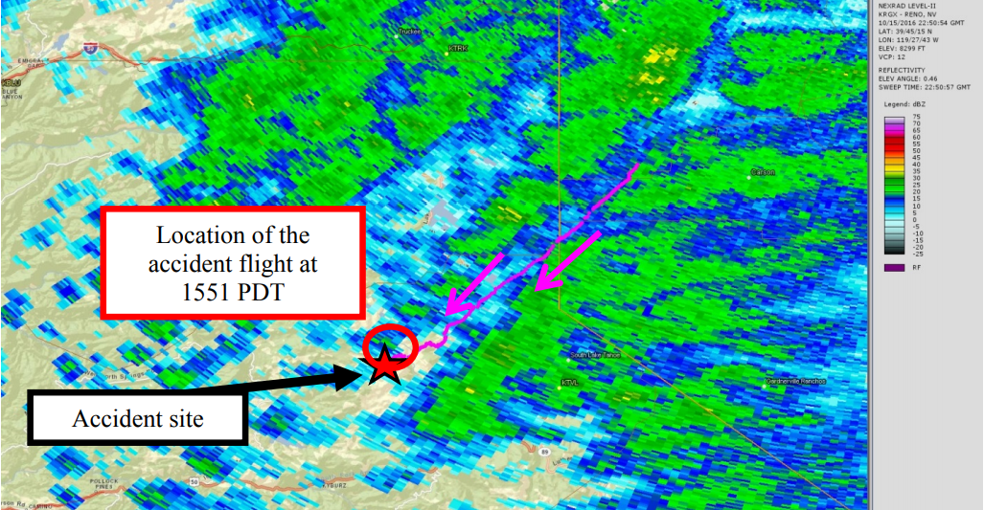
Meteorology
Notes:
There were no lightning strikes near the accident site at the accident time.

Slide 19
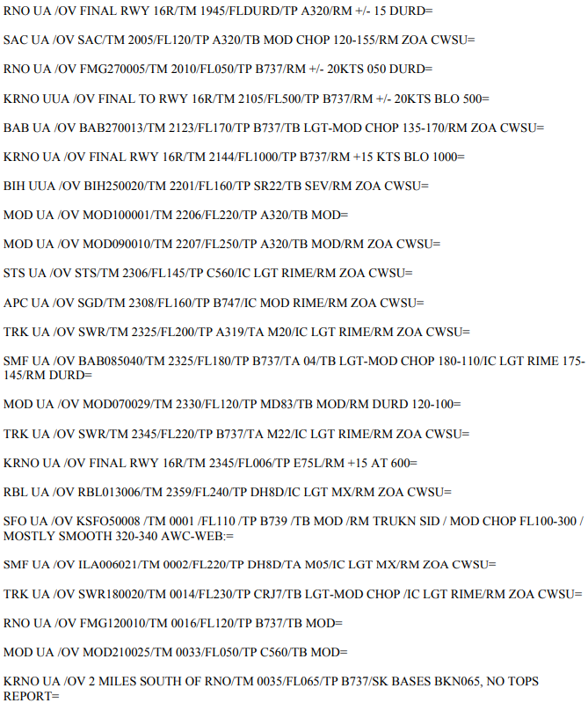
Meteorology
Notes:
PIREPS 4 hours prior to the accident to 2 hours after the accident time below FL250

Slide 20
Meteorology
Oakland (ZOA) CWSU issued an MIS at 0821 PDT discussing strong westerly winds impacting the Sierra mountain range and may cause SEV TURB, mountain wave activity, strong up and downdrafts, and LLWS through the early evening hours.

Slide 21
Meteorology
ZOA CWSU issued the first CWA at 0908 PDT warning areas of LLWS from the surface to 1,000ft, moderate mountain wave activity, and strong updrafts.
Conditions were expected to continue beyond 1108 PDT

Slide 22
Meteorology
AWC called ZOA CWSU at 1050 PDT coordinating a future SIGMET for SEV TURB for the Sierra Mountains and parts of NV.
AWC and ZOA agreed ZOA would continue issuing CWAs until SIGMET was issued

Slide 23
Meteorology
At 1100 PDT ZOA CWSU issued second CWA warning areas of LLWS from the surface to 1,000ft, moderate mountain wave activity, and strong updrafts with conditions expected to continue beyond 1300 PDT.
At 1236 PDT ZOA CWSU issued third CWA (103) to cancel previous CWA (102) and telling pilots to see SIGMET November 1.

Slide 24
Meteorology
November 1 issued before accident flight took off warning of SEV TURB BLO 150 due to strong low – level winds and mountain wave activity with strong updrafts and LLWS
SIGMET November 2 valid for the accident site at the accident time
Issued at 1527 PDT replacing November 1 that was issued at 1232 PDT valid through 1632 PDT.
Warned of OCNL SEV TURB BLO 180 due to strong low-level winds & mountain wave activity with strong updrafts and LLWS.

Slide 25
Meteorology
ZLC CWSU issued 2 MISs
Oct 14 at 2005 PDT and Oct 15 at 0930 PDT
Discussing widespread rain, showers, mountain snow, low ceilings and visibility, possible mountain waves, LLWS, and strong surface winds.

Slide 26
Meteorology
AIRMETs Tango, Zulu, and Sierra were issued at 1345 PDT – valid at the accident time for the accident site
Forecasted moderate turbulence b/w
FL180 and FL420, moderate turbulence
BLO 180, sustained surface winds greater than 30kt, LLWS, moderate icing b/w freezing level (6,000-11,000ft) and FL220, IFR conditions, and mountain obscurations.

Slide 27
Analysis
Pilot sent his wife in-flight photos of limited visibility, dust storms, and lenticular clouds in the general direction of his intended route

Slide 28
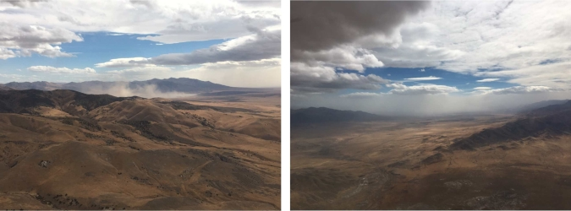
Analysis

Slide 29
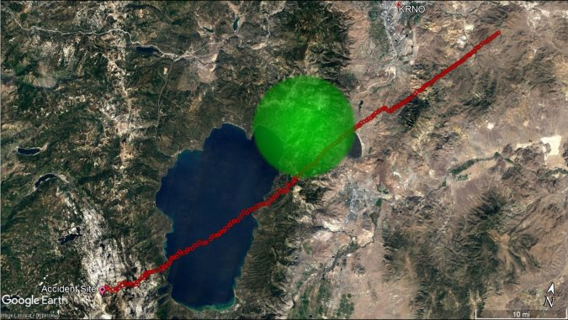
Analysis
During the last 1.5 minutes of flight, the airplane descended from 10,800 ft to the last radar-recorded altitude of 9,700 ft.

Slide 30
Analysis
Did not receive an official weather briefing
Likely using a tablet-based mobile app
Conversations with wife/controller indicated pilot had a source of aviation weather

Slide 31
Analysis
Worsening weather conditions (extreme surface winds at airports) and TFR before crossing a large lake may have contributed to pilot’s reluctance to discontinue the flight and land
Familiarity with area, route, and relative close proximity of destination may have lulled pilot into false sense of security, predisposing him to continue the flight.

Slide 32
Probable Cause
National Transportation Safety Board:
“The noninstrument-rated pilot's decision to depart on and continue a flight over mountainous terrain into forecast instrument meteorological conditions, icing, and hazardous wind conditions that exceeded the airplanes performance capabilities and resulted in an uncontrolled descent and collision with terrain.”

Slide 33
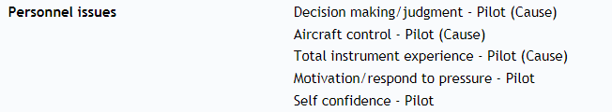
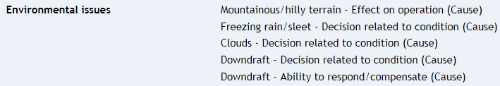
Probable Cause

Slide 34
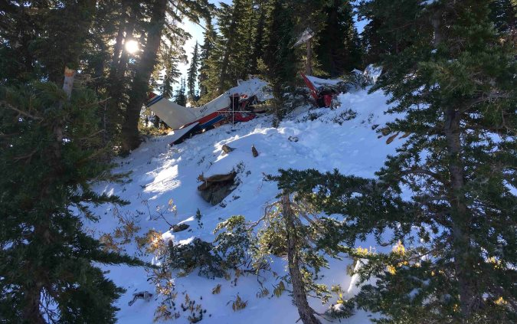

Slide 35
Conclusion
Forecast impacts
General aviation community
Notes:
Meteorologists must remember that every product, warning, and decision made providing service to the aviation community is significant and always has impacts. Meanwhile, the general aviation community must continue to recognize the significant impacts weather has on aviation.

Slide 36
End
Sources:
https://goo.gl/7ZtwFt
https://goo.gl/6kQjde

